Slide 1
Introduction To Models
Welcome to machine learning!

Slide 2
Table Of Contents
High Level Overview:
Intersection between data science and machine learning
Machine learning overview
Types of machine learning problems
Understand how a model learns
Development process of building a machine learning model

Slide 3
Intersection of Data Science and Machine Learning

Slide 4
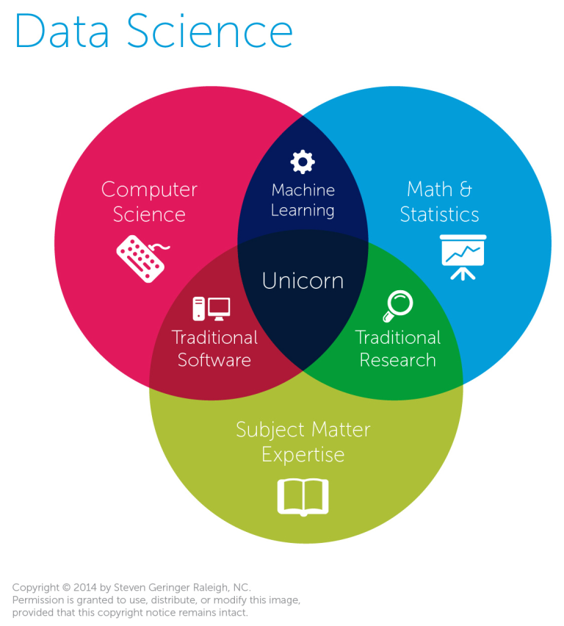
Data Science
Is an intersection of multiple fields.

Slide 5
Data Science Flow
Exploratory
Data
Analysis
Data science is the iterative process of analyzing, cleaning, and feature engineering data.
Extracts meaningful information and actionable insights.
Their insights drive business decisions to achieve business objectives.
The Flow:
Analyze data
Clean data
Create new data features
Note: iterative process
Iterative Process
Feature Engineering
Clean
Dataset
Notes:
What we have been working on

Slide 6

Data Science Process
Raw
Data Collected
Structured
Data
Models &
Algorithms
Iterative Process
Restructure
Evaluate,
Communicate,
& Verbalize
Report
Data
Product
—————
Model Ready For Prediction
Make Decisions
Reality
Notes:
Data is processed during the data science flow of EDA, Cleaning, and Feature Engineering so that we can actually use the data
Solving one problem can help collect data for the next problem

Slide 7
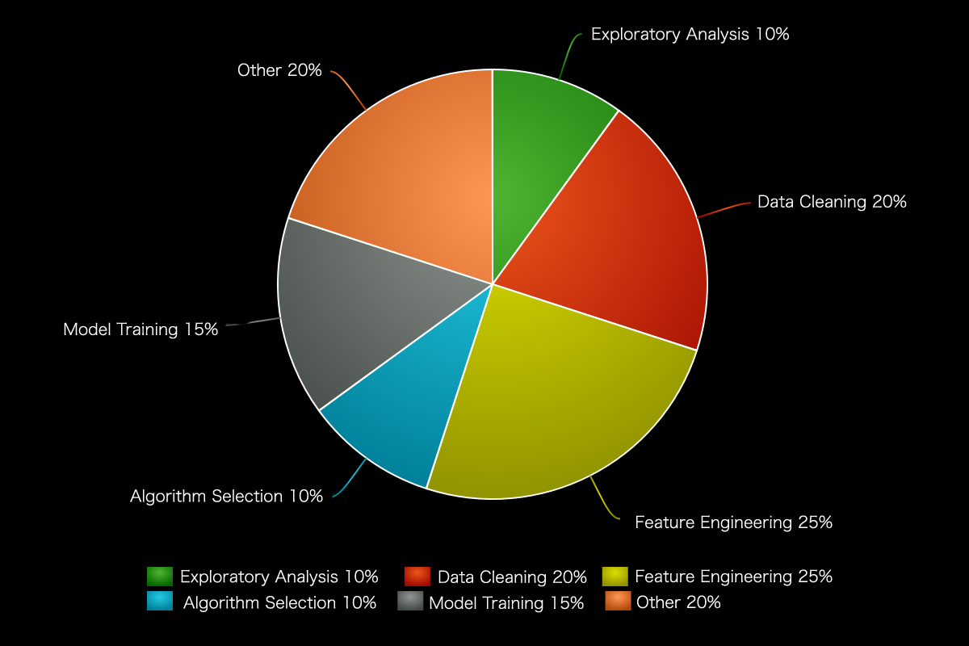
What Goes Into A Successful Model?

Slide 8
Exploratory Data Analysis
Exploratory Data Analysis (EDA) is the first step in your data analysis process.
Here, you make sense of the data you have at your disposal and figure out which features of the data may be the best suited for the machine learning task at hand.

Slide 9
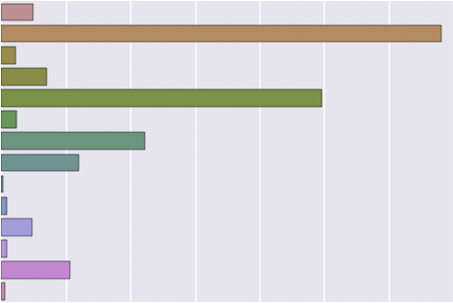
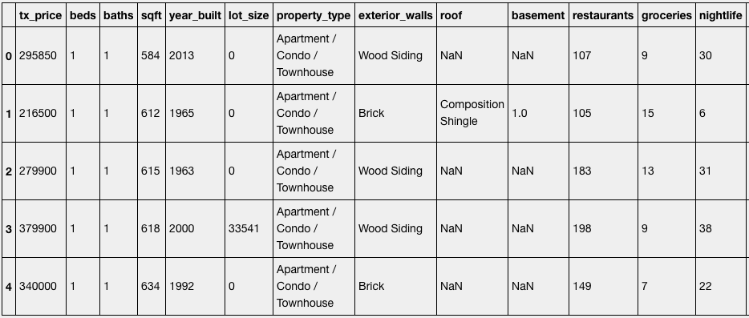
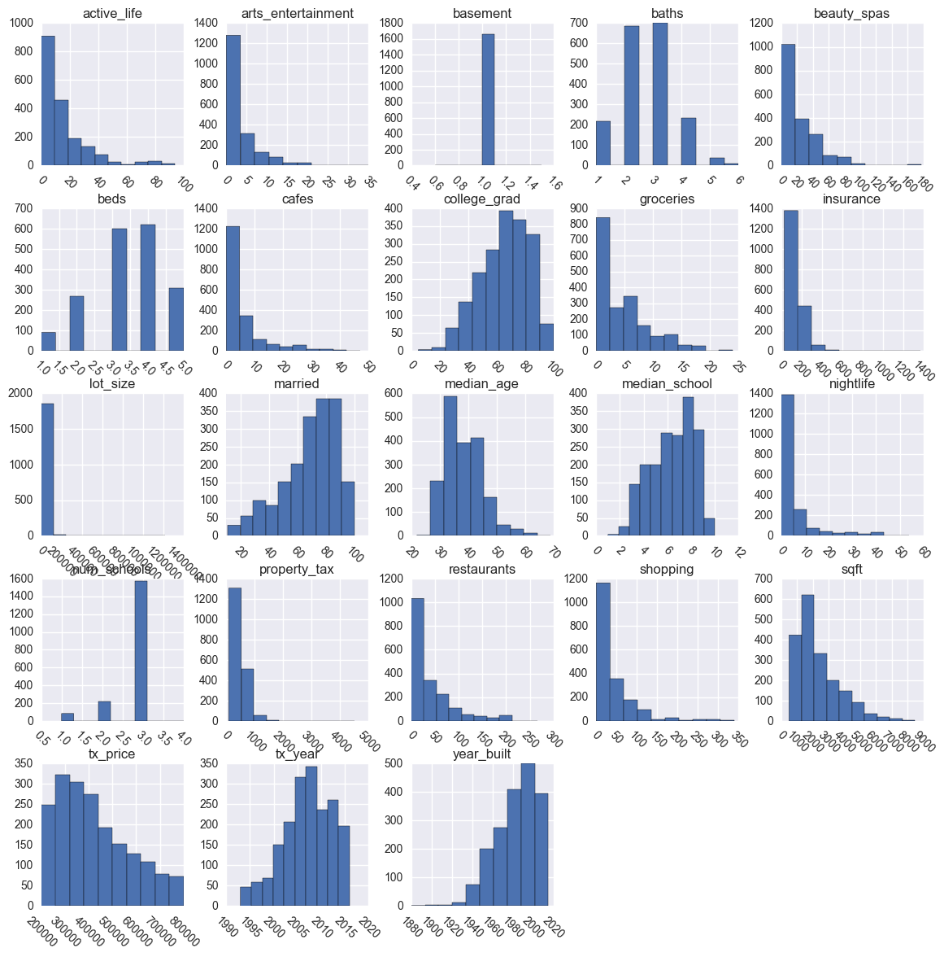

Exploratory Data Analysis - Topics Covered
Display example observations from the dataset using excel or pandas just to name a few.
Plot categorical distributions using bar plots
Plot Numerical Distributions
Study Correlations

Slide 10
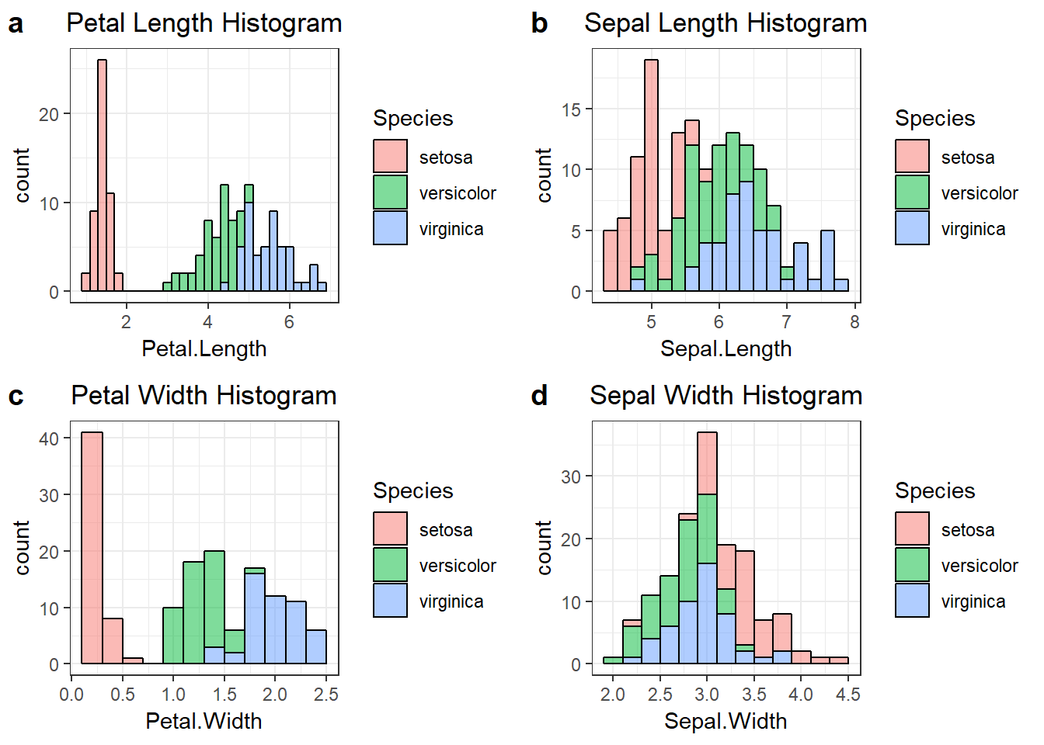
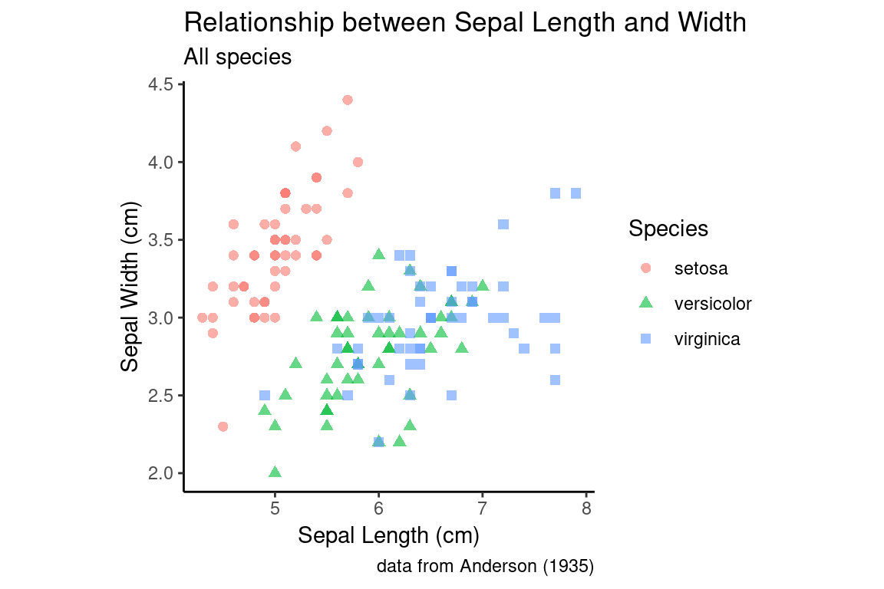
Exploratory Analysis Example
Do you notice any patterns?

Slide 11
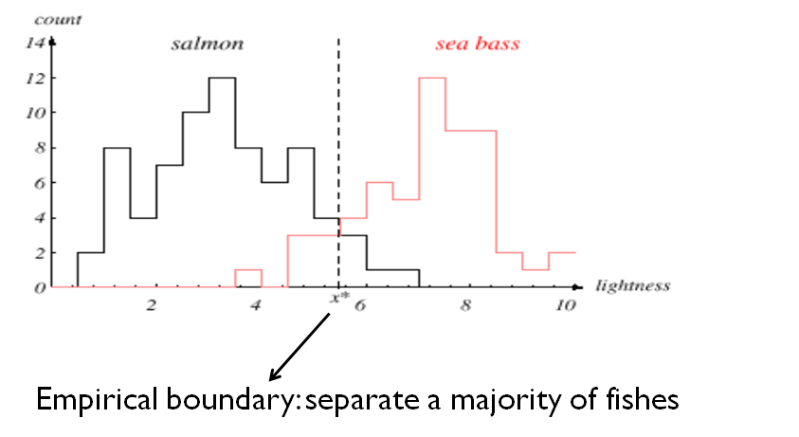
Exploratory Analysis Example
Do you notice any patterns?
Notes:
Could we have a machine learning model for salmon?
Is the overlap?

Slide 12
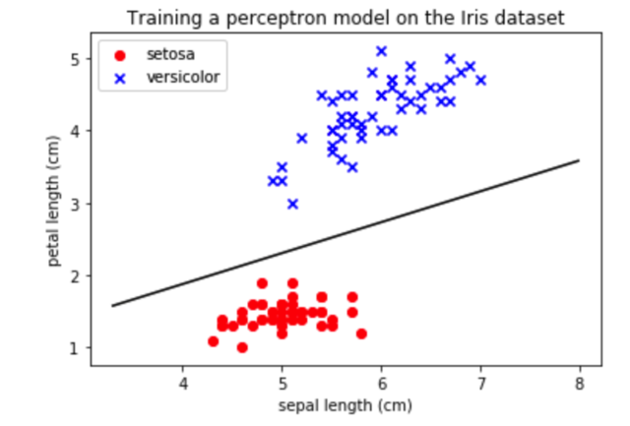
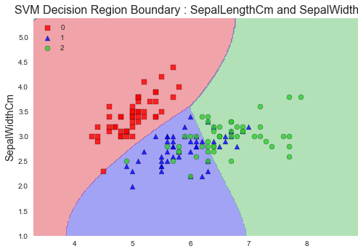
Goal Of Machine learning
Machine Learning tries to identify the patterns of the input features and tries to build a mathematical model such that it will be able to accurately predict an output with unseen observations in the future.
“Machine Learning is the field of study that gives computers the ability to learn without being explicitly programmed.” - Arthur Samuel (1959).
Outlier?
Notes:
Talk about if we have good data, i.e. skewed data points
Outliers, whether we should remove a point or if that outlier is a good point for data we have not observed yet in the data set but is still a good piece of data for the real world distributions that we just haven’t send/collected data from yet
Overfitting; train so well on data that the model doesn’t perform well in real life
What is bias? Collecting bias data?
Personal Questions:
What are some of your mental models? Work off of some of the problems you see on a day to day.
Ex. Slowing down at a stoplight you can’t see because it tends to have a high distribution of yellow and red lights whenever you drive by.

Slide 13

Data Cleaning
Data cleaning is one those things that everyone does but no one really talks about. Proper data cleaning can make or break your project. Professional data scientists usually spend a very large portion of their time on this step.
It’s important to note the MORE amounts of good data beats fancier and complex algorithms.
In other words... if you feed a model in garbage then you will get garbage as a result.

Slide 14
Feature Engineering
Feature engineering is about creating new input features from your existing ones.
In general, you can think of data cleaning as a process of subtraction and feature engineering as a process of addition.
Important note: We do not want to create new features by multiplying old features by scalars. Rather we want to create new features through the use of other features being operated on with other features to bring new insight.
i.e.
Bad: df[‘new_feature’] = df[‘feature_one’] * some_number
Good: df[‘new_feature’] = df[‘feature_one’] * df[‘feature_two’]
Feature engineering has limitless possibilities and is a skill that will naturally improve over time.

Slide 15
Data Science Resources:
Individual Resources:
EDA and Data Cleaning
3 Ways Of Dealing With Outliers
Tips On Feature Engineering
Online Resources:
Data Science Handbook
Notes:
Run through resources to show what value they provide

Slide 16
What Is Machine Learning?

Slide 17
Definition Of Machine Learning
“Machine Learning is the field of study that gives computers the ability to learn without being explicitly programmed.” - Arthur Samuel (1959)
Well-posed Learning Problem:
“A computer program is said to learn from experience E with respect to some task T and some performance measure P, if its performance on T, as measured by P, improves with experience E.” - Tom Mitchell (1998)

Slide 18

Steps Of Machine Learning
Gathering data
Preparing that data
Choosing a model
Training
Evaluation
Hyperparameter tuning
Prediction

Slide 19
Types Of Machine Learning Problems

Slide 20
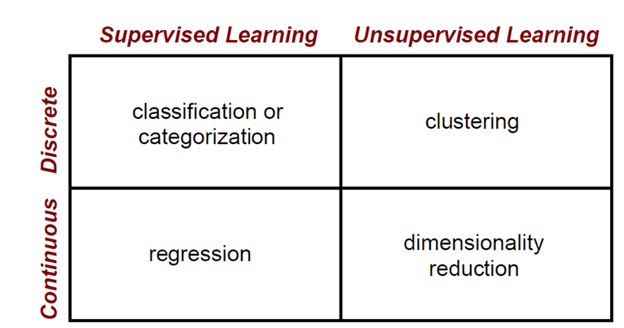
Common Machine Learning Problems
Read this article which explains the different types of machine learning problems
Overview:
Labels known
Labels not known

Slide 21
Supervised Learning
Each observation must be labeled with a "correct answer."
Only then can you build a predictive model because as the model “learns” the data, its predictions are being tested against those labels, aka "supervising" it.

Slide 22
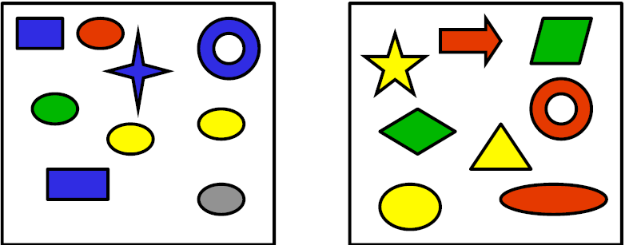
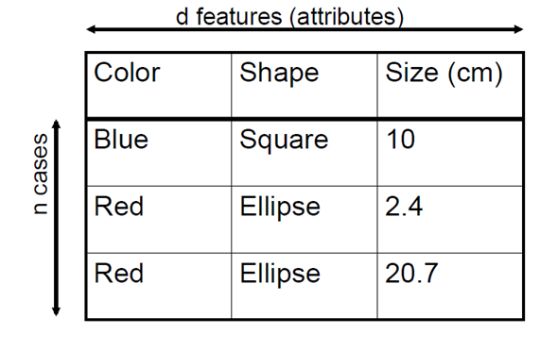

Classification
Discrete Supervised Learning:
Classification is the task for modeling categorical (a.k.a. "class") target variables.
Binary classification
Multi-class classification
Example: Predict spam emails
Type 1
Type 2
Label
Type 1
Type 1
Type 2
Yellow | Circle | 5
?

Slide 23
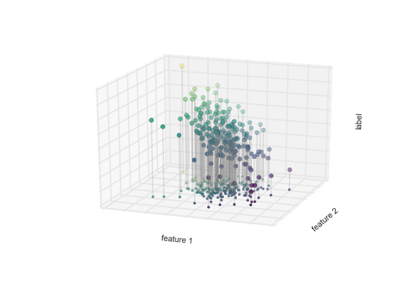
Regression
Continuous Supervised Learning
Regression is the task for modeling continuous target variables.
Example: Predicting house prices
feature 1 | feature 2
1 | 0.5
3 | 2.4
8 | 5
Label
1.5
4.6
7.5
feature 1 | feature 2
7 | 6
Prediction
?

Slide 24
Unsupervised learning
In unsupervised learning, the goal is to identify meaningful patterns in the data. To accomplish this, the machine must learn from an unlabeled data set. In other words, the model has no hints how to categorize each piece of data and must infer its own rules for doing so.

Slide 25
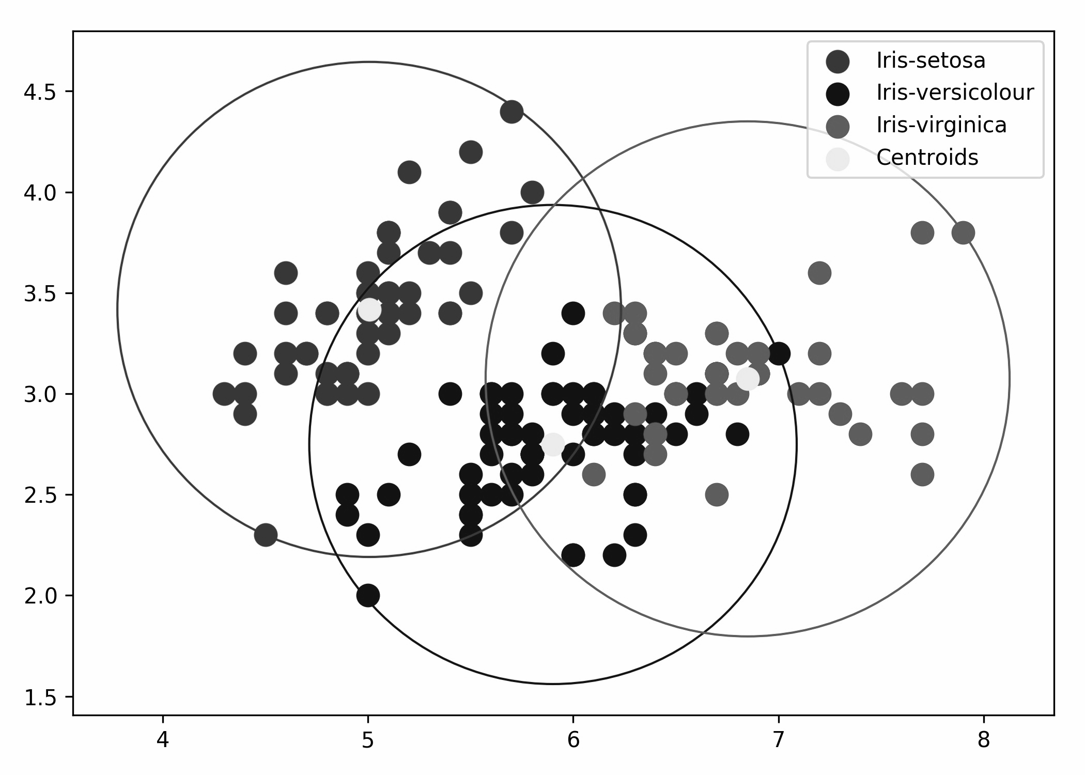
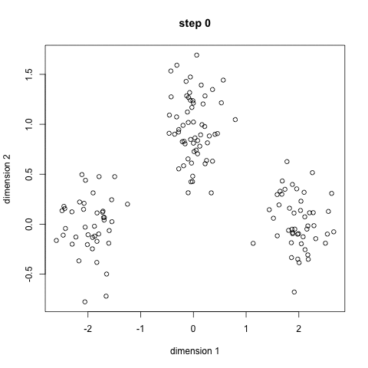
Clustering
Discrete Unsupervised Learning
Clustering is a task that involves the grouping of data points.
In theory, data points that are in the same group should have similar properties and/or features, while data points in different groups should have highly dissimilar properties and/or features.
Example:
Classification among different species of plants and animals
Don’t know label of each observation,
must learn from an unlabeled data set

Slide 26

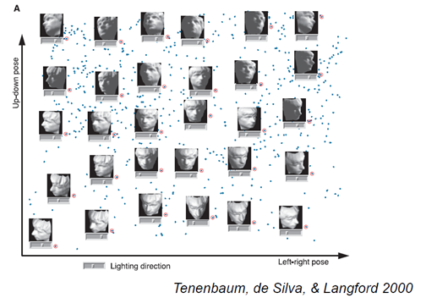
Dimension Reduction
Continuous Unsupervised Learning
Dimension Reduction is the task where labels or other information are inferred from the structure of the dataset itself.
Dimensionality reduction pulls out some low-dimensional representation of data that in some way preserves relevant qualities of the full dataset. It converts higher dimensions of data to less dimensions.
Example: Facial recognition
Features of high dimension: 32 pixels * 32 pixels that can
hold a grey scale value from 0 (black) - 256 (white)

Slide 27
Note:
Individual Resources:
What is machine learning
What is machine learning in more depth
Regression Resource 1
Regression Resource 2
Classification (logistic regression)
Clustering
Online Resources:
Data Science Handbook
This class is going to be more of an application based class rather than diving deep into machine learning.

Slide 28
Development Process
Individual Resources:
Problem Framing
How to develop a problem
Scientific method
Ml development process
Online Resources:
Data Science Handbook
Nomenclature dictionary of machine learning terms

